Slide 1
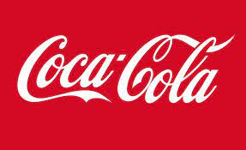
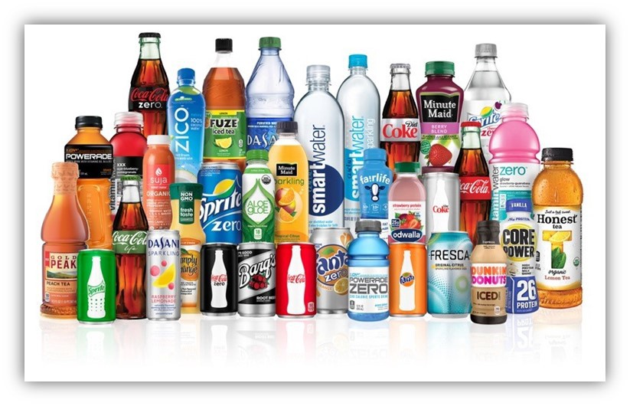
Notes:
Coca-Cola Company is the world's largest company, founded in the year 1892 and incorporated in 1919. The company deals with more than 500 nonalcoholic beverage brands (sparkling beverages) in the market and still beverages such as water, juice, ready-to-drink coffees, and energy drinks. . It owns and markets brands such as Coca-Cola, Fanta, sprite, and diet coke in the U.S. and is sold to more than 200 countries worldwide. They make their products available to customers and consumers through controlled bottling and distribution operations.

Slide 2
SWOT ANALYSISS: Strengths
Strength is the company's external environment that focuses on the company's brand awareness
Coca-Cola's classic red and white logo makes its brand globally recognized
The company plans to increase its marketing effort and increase product innovation
. The company plans to increase its marketing effort and increase product innovation that will win the market share in the future.
Notes:
Strength is the company's external environment that focuses on the company's brand awareness and distribution network. In brand awareness, Coca-Cola has the best-recognized brand globally, which is famous and reverberate with consumers of all age. Coca-Cola competes with PepsiCo, which produces the same product. Coca-Cola's classic red and white logo makes its brand globally recognized, thus maintaining its topmost position as the straightforward winner. Both companies have increased market share, but Coca-Cola has the top post. The business producer retains its part by ensuring consumers who are fans of the product stick with the company without shifting to other brands. The company plans to increase its marketing effort and increase product innovation that will win the market share in the future.

Slide 3
Weaknesses; water management
Water is the main ingredient of the company's product which is crucial in its processing process.
Water is limited to most countries, thus causing challenges due to overexploitation and rising demand for food and other products that require water in manufacturing processes.
Water becomes scarce, and its quality deteriorates as the demand for water increases, thus making Coca-Cola incur extra costs, thus affecting its profitability.
It makes it helpful o the success of the community served by Coca-Cola.
Notes:
Water is majorly used by all companies that require manufacturing processes for the production of agricultural ingredients. Water is limited to most countries, thus causing challenges due to overexploitation and rising demand for food and other products that require water in manufacturing processes. Water becomes scarce, and its quality deteriorates as the demand for water increases, thus making Coca-Cola incur extra costs, thus affecting its profitability.

Slide 4
Weaknesses; Foreign Currency Fluctuation
Foreign currency is another weakness to the Coca-Cola company. It earns revenue, pays the expenses, and has the liabilities in countries using different currencies apart from the U.S. dollar.
This brings a challenge to the company in its revenue operations outside the United States.
On its financial statement, the company translates revenue, income, and expenses into U.S. dollars affected by the exchange rate.
K.O. helps in reducing the fluctuations rate from foreign currencies, mostly from developing countries.
Notes:
It earns revenue, pays the expenses, and has the liabilities in countries using different currencies apart from the U.S. dollar. This brings a challenge to the company in its revenue operations outside the United States. On its financial statement, the company translates revenue, income, and expenses into U.S. dollars affected by the exchange rate. Therefore, an increase or decrease in the value of the U.S. dollar may bring Weaknesses in some currencies, which might be offset by strengths in others over time due to the geographic diversity of the company’s operations.

Slide 5
Opportunities; diversification
The company has his diversification through its hard work in improving the rapidly–growing beverage categories.
It has the opportunity of owning Keurig Green Mountain.
It is focusing on increasing new Keurig Kold devices featuring Coke-branded products for the future platform.
the business will boost both top and bottom lines establishing inroads to young customers.
K.O. will help increase the relationship with coffee, energy, and other health drinks businesses.
Notes:
It has the opportunity of owning Keurig Green Mountain. It is focusing on increasing new Keurig Kold devices featuring Coke-branded products for the future platform. The company has also purchased a 17% stake in the monster beverage, which helps access popular energy drinks. In plans, the business will boost both top and bottom lines establishing inroads to young customers.

Slide 6
Opportunity; Extended Reach
Coca-Cola has extended reach as the global population is steadily increasing through focusing on strengthening its business lines.
Developing countries have a challenge in clean water, thus increasing the demand for bottled water.
There is also demand for the company's latest juice and coffee in India and China.
These sections have increased the need for Coca-Cola beverages other than traditional drinks, thus differentiating its portfolio and delivering emerging markets with new glasses for a long time.
Notes:
Coca-Cola has extended reach as the global population is steadily increasing through focusing on strengthening its business lines. Developing countries have a challenge in clean water, thus increasing the demand for bottled water. There is also demand for the company's latest juice and coffee in India and China. These sections have increased the need for Coca-Cola beverages other than traditional drinks, thus differentiating its portfolio and delivering emerging markets with new glasses for a long time.

Slide 7
Threats; Nutritious Selections
Presence of threat in nutritional selection through soft drinks provider sufferings.
cultural shift on Natural and organic products making many customers prefer smoothies, nourishing waters, and healthy beverages.
Buyers have neglected core soda offering with a high amount of sugar with artificial sweeteners.
health experts have called for eliminating food and beverage with sugar since they put people at risk of obesity, diabetes, ad heart-related disease.
a heavy tax on soda and sugary soft drinks, thus creating negative perception of these beverages.
Notes:
There has been a threat in nutritional selection through soft drinks provider sufferings. There has been a cultural shift on Natural and organic products making many customers prefer smoothies, nourishing waters, and healthy beverages. Buyers have neglected core soda offering with a high amount of sugar with artificial sweeteners. These challenges, therefore, seem to continue as customers prefer proper dietary requirements and exercise programs. Additionally, health experts have called for eliminating food and beverage with sugar since they put people at risk of obesity, diabetes, ad heart-related disease. The federal government has also placed a heavy tax on soda and sugary soft drinks, thus creating negative perception of these beverages.

Slide 8
Threats; Indirect Competition
Competition from other companies such as Starbucks and Dunkin' Brands Group
it gives customers health alternatives and choices which are not matched by Coca-Cola but other companies.
Patrol carried out by small licenses leads this business to deliver the beverage at lower prices.
Industry data suggest potential customers will continue to be pulled away from essential drink selections in favor of customizable options
Notes:
Competition from other companies such as Starbucks and Dunkin' Brands Group, which have indirect competition. Thus it gives customers health alternatives and choices which are not matched by Coca-Cola but other companies. Patrol carried out by small licenses leads this business to deliver the beverage at lower prices. Industry data suggest potential customers will continue to be pulled away from essential drink selections in favor of customizable options that carry a more significant nutritional benefit

